Slide 1
Chain whisperVerse
Cross-chain Messaging and Token Transfers via LayerZero V2

Slide 2
Project Overview
Chain whisperVerse Messenger is a cross-chain communication app built on LayerZero V2.
Supports Solana and EVM chains (Ethereum, Polygon, Arbitrum)
Allows seamless text messaging and token transfers
Demonstrates Chain whisperVerse interoperability

Slide 3
Key Features
Cross-chain text messaging and token transfer
Built on LayerZero V2
Supports both Solana and EVM chains
Clean, responsive UI
Focus on scalability and modular architecture

Slide 4
How It Works (In Simple Terms)
Users can send tokens and messages from one blockchain to another
LayerZero handles complex communication behind the scenes
Mock services simulate real interactions during development

Slide 5
Technologies Used
LayerZero V2 Protocol
Solidity for EVM contracts
Rust-based Solana Programs
Mock services for testing
Frontend built with modern web tech (react with vite)

Slide 6
Current Limitations
No user authentication yet
Primarily a technical demo
Mock services instead of real blockchain transactions in development phase

Slide 7
Vision & Future Scope
Expand to more chains
Integrate real token transfers
Add user authentication
Enable real-world use cases: cross-chain chat, asset bridging apps

Slide 8
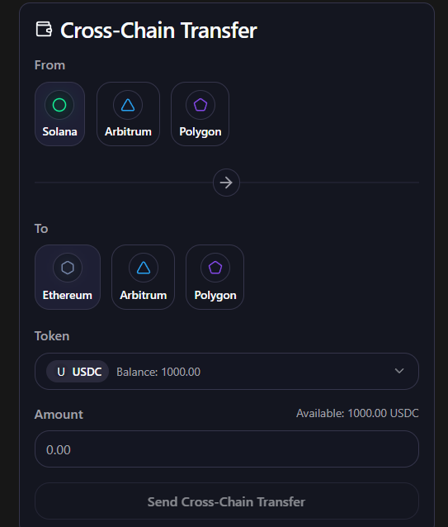
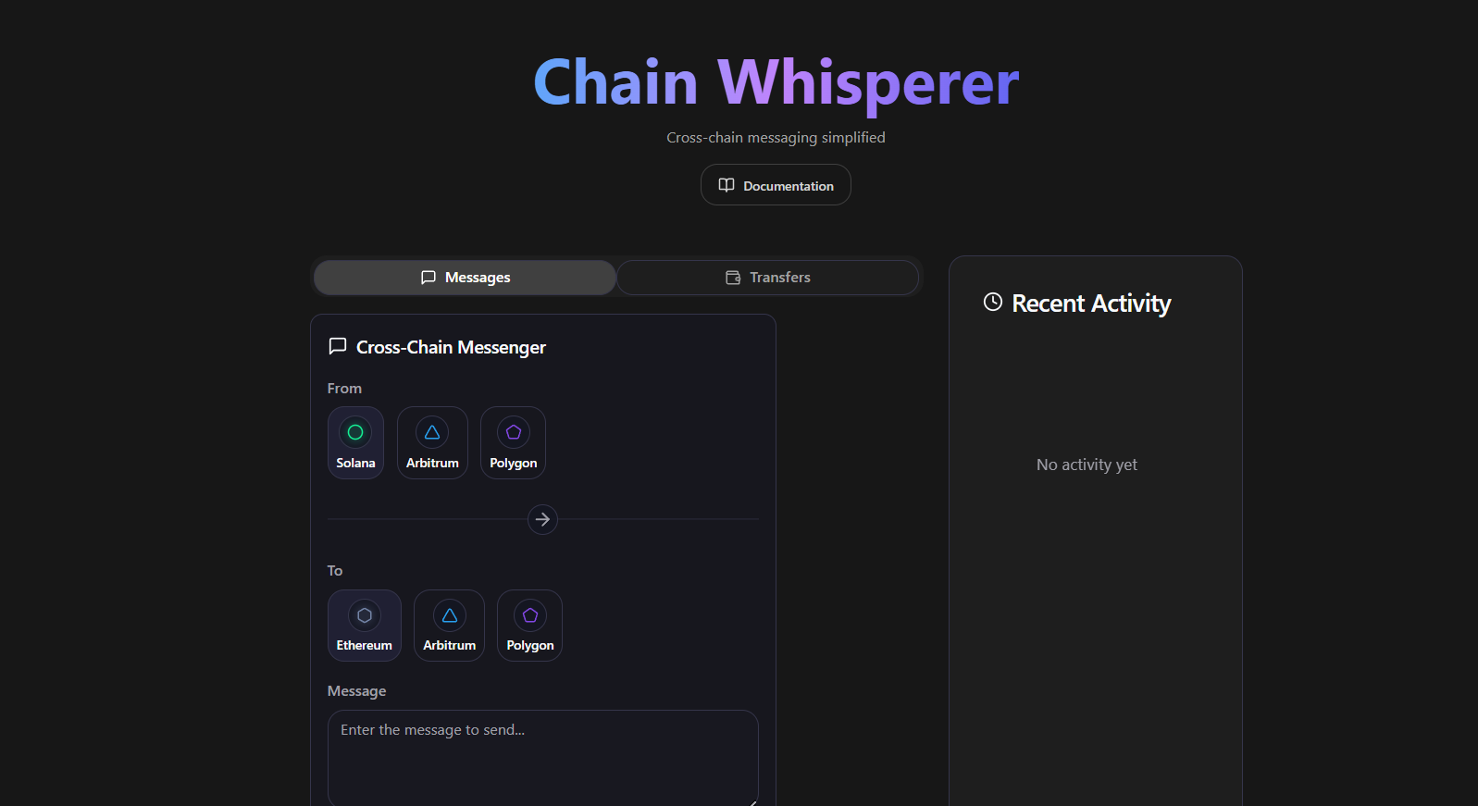
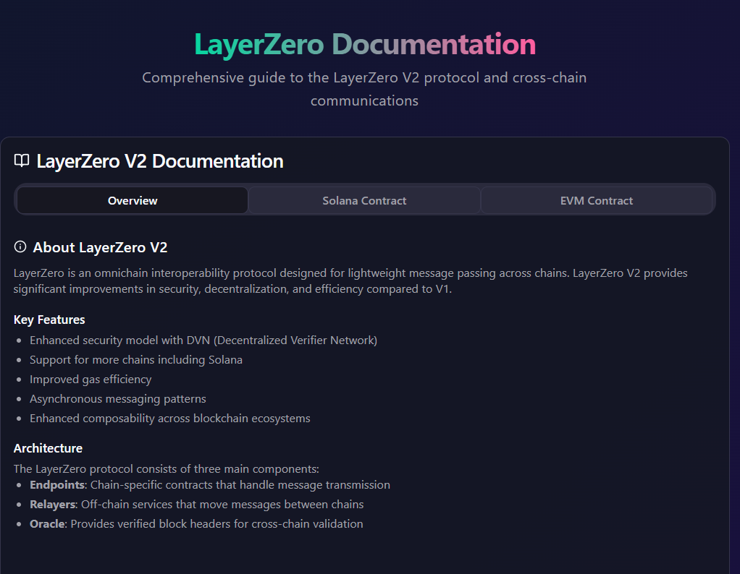
UI Demonstrations

